Slide 1

Kalman Filter Simplified
Jorge Jurado-Garcia

Slide 2
Goal and Breakdown
Goal: Have an intuitive understanding of why and how Kalman Filter is used.
Understand its disadvantages and advantages
Comparison with common filter(s): Moving average filter(s)
NO COMPLEX MATH!

Slide 3
What is uncertainty and noise?
Noise: unwanted interference that degrades a signal. Makes the signal harder to understand and predict
Uncertainty : Confidence of an event, or model
Two Main types:
Measurement Uncertainty
Estimated Uncertainty
Error Uncertainty

Slide 4
Examples in Fiancé and Engineering
Small Price Movements and corrections is noise
Difficult to determine actual trends or actual changes
Any Models or forecasting WILL HAVE SOME TYPE OF UNCERTAINTY.
Object Trackers:
Noise(s): Thermal Noise, ADC Conversions, Variance in acceleration
Due to this noises any THEORETICAL MODEL will be wrong!

Slide 5
Kalman Filter to the Rescue
Estimation Algorithm that provides Quick, accurate, and precise estimates of a system with the presence of uncertainty due to noise.
Can Predict Future Events
Self alliterative – No selective windowing
Fast Processing with large amounts of data

Slide 6
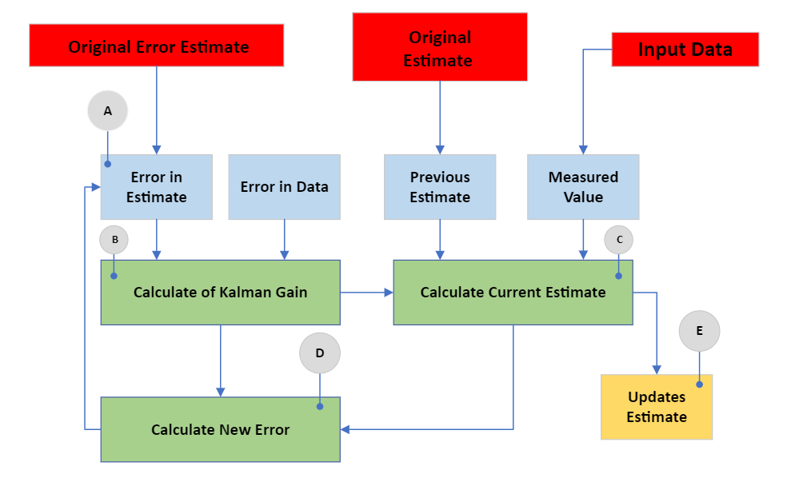
Simplified Flowchart

Slide 7
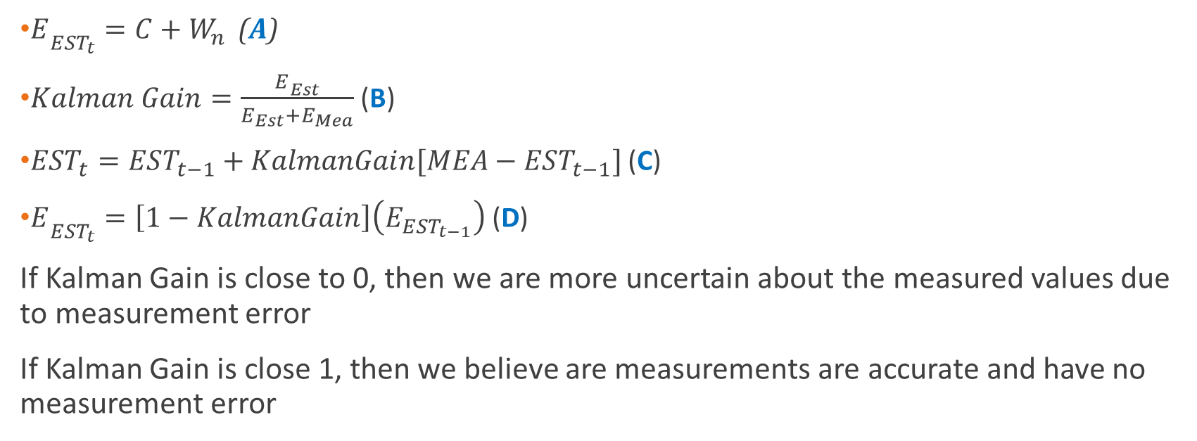
Three Key Questions
$E­_{EST_{t}}=C+W_{n}$ (A)
$Kalman Gain=\frac{E­_{Est}}{E_{Est}+E_{Mea}}$ (B)
${EST}_{t}=EST_{t−1}+KalmanGain[MEA−EST_{t−1}]$ (C)
$E­_{EST_{t}}=\left[1−KalmanGain\right]\left(E_{EST_{t−1}}\right)$ (D)
If Kalman Gain is close to 0, then we are more uncertain about the measured values due to measurement error
If Kalman Gain is close 1, then we believe are measurements are accurate and have no measurement error

Slide 8
1-D Example
Noisy Coefficient |  | Initial Estimate |  | Initial Error in Estimate | Initial MEA | Error in MEA
0.1 |  | 90 |  | 10,000.10 | 31 | 13.69
Time | Measurement | True Value | Error in Measurement | Kalman Gain | Error in Estimate | Estimate
-1 |  |  |  |  | 10000.10 | 90.00
0 | 31 | 34.9 | 13.69 | 0.9986 | 13.77 | 31.08
1 | 39 | 35.1 | 13.69 | 0.5015 | 6.97 | 35.05
2 | 32 | 34.85 | 13.69 | 0.3372 | 4.72 | 34.02
3 | 37 | 35.01 | 13.69 | 0.2562 | 3.61 | 34.79
4 | 34 | 34.99 | 13.69 | 0.2086 | 2.96 | 34.62
5 | 36 | 34.5 | 13.69 | 0.1776 | 2.53 | 34.87
6 | 35 | 35.3 | 13.69 | 0.1560 | 2.24 | 34.89
7 | 31 | 35.2 | 13.69 | 0.1404 | 2.02 | 34.34
8 | 39 | 35.6 | 13.69 | 0.1287 | 1.86 | 34.94
9 | 38 | 34.6 | 13.69 | 0.1197 | 1.74 | 35.31
10 | 33 | 34.1 | 13.69 | 0.1127 | 1.64 | 35.05

Slide 9
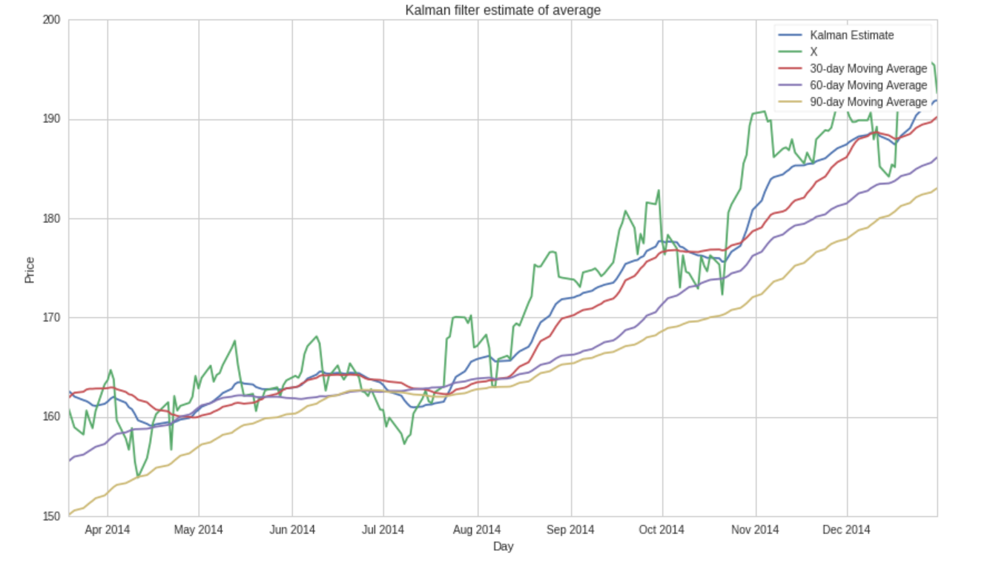
Comparison to Moving Average Filters

Slide 10
Disadvantage(s) of Model
In rapid change situations, Kalman Filter has a slow reaction speed
For non-linear systems Kalman Filter becomes more complex
Therefore, Kalman Filter are mostly only used for linear systems
The more inputs into your model the more computational expensive

Slide 11
Interactive Python Kalman Filter
Go to Python Script

